Slide 1
Block Scope Of Let: You will build on your understanding of variable scope. When you declare a variable with let inside a block, that variable exists only within that block. Try this out in your browser console to test how the scope impacts the variables you define.

Slide 5
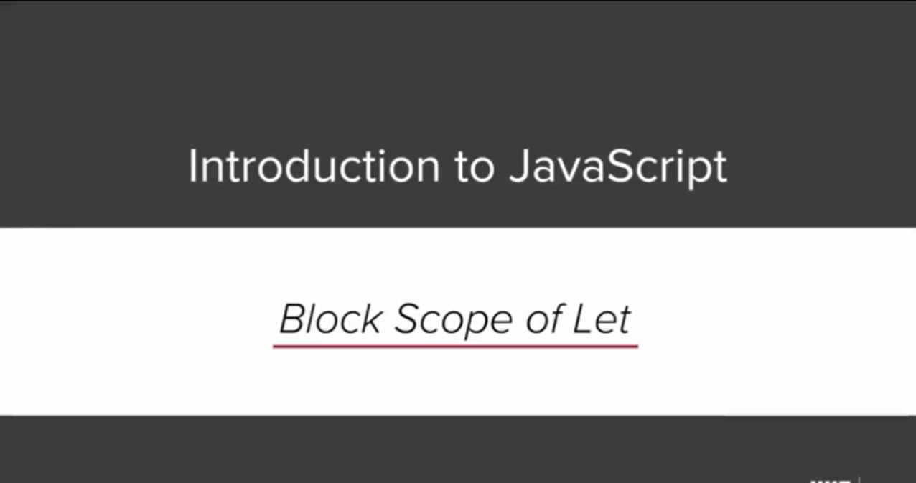

Slide 6
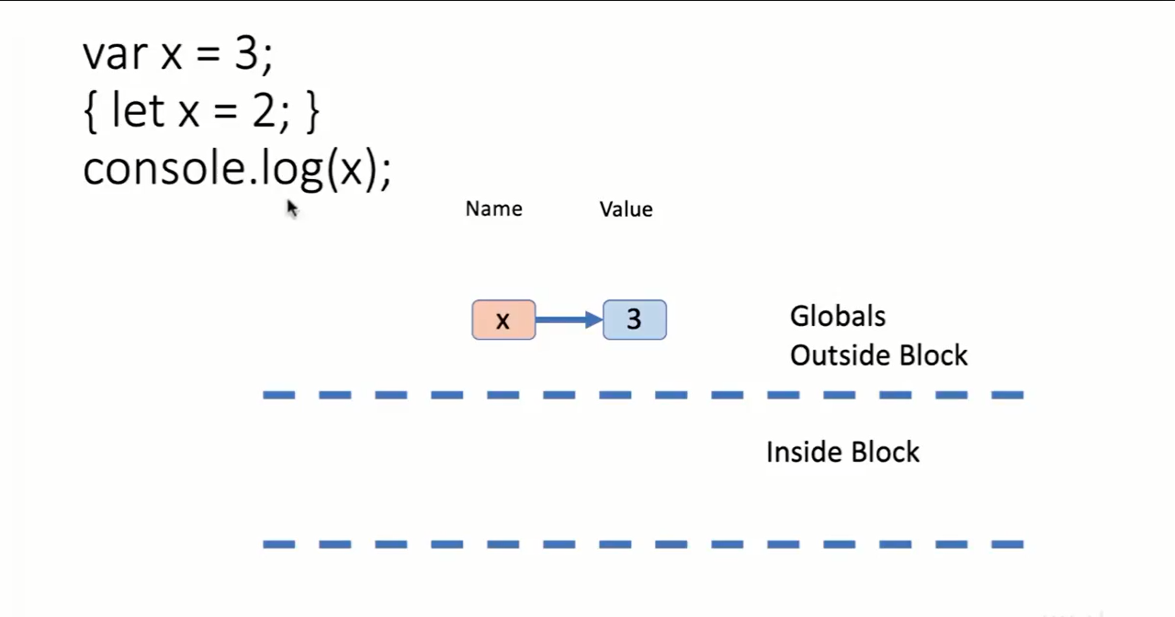

Slide 7
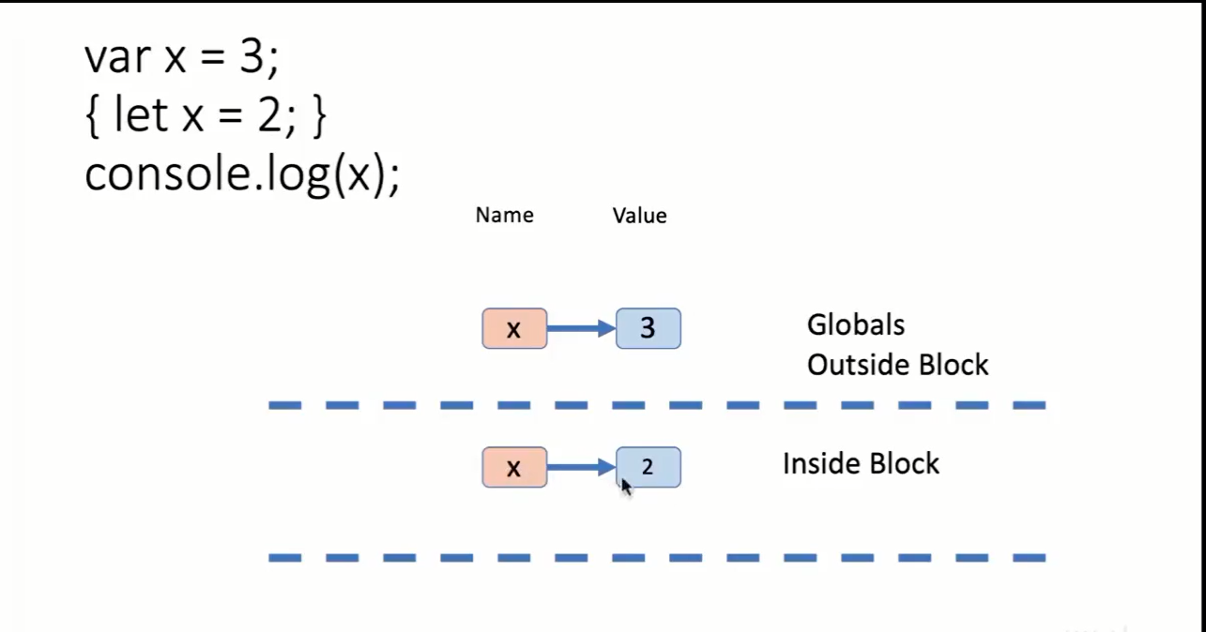

Slide 8
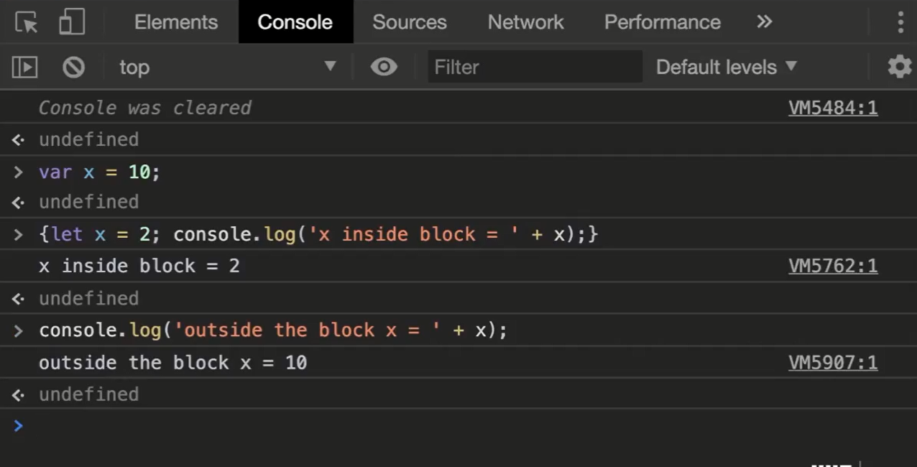

Slide 9
Function Call With Argument: In this example, you are going to see what happens when a function is called. You will see that temporary variables are created within the block scope and the function performs operations on them. These variables cease to exist when they are no longer referenced. Try coding this example in your browser console to see how it works.
Function Call With Object For Argument: Now, you are going to see how this works when a function that has an object as the argument is called. In this example, you will see that we can change the value of an object. Practice working with objects in your browser console as well as passing in arrays and primitive types (numbers, strings, etc.) to see how they behave.

Slide 10
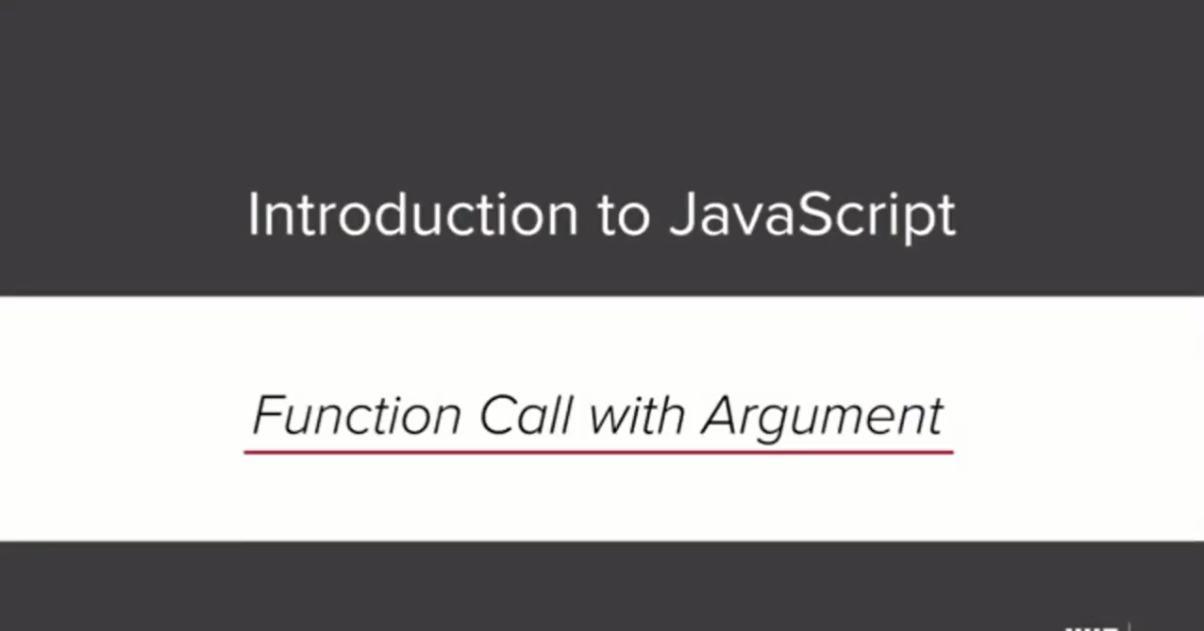

Slide 11
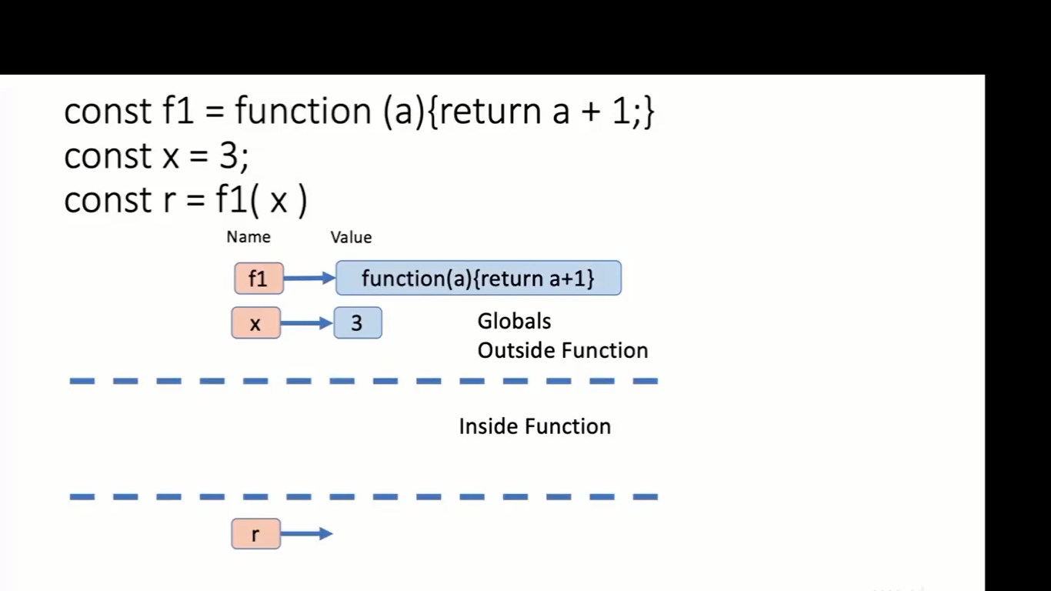

Slide 12
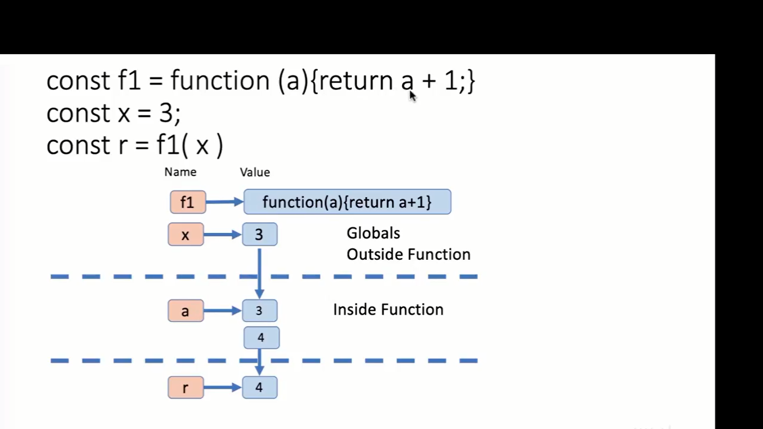

Slide 13


Slide 14
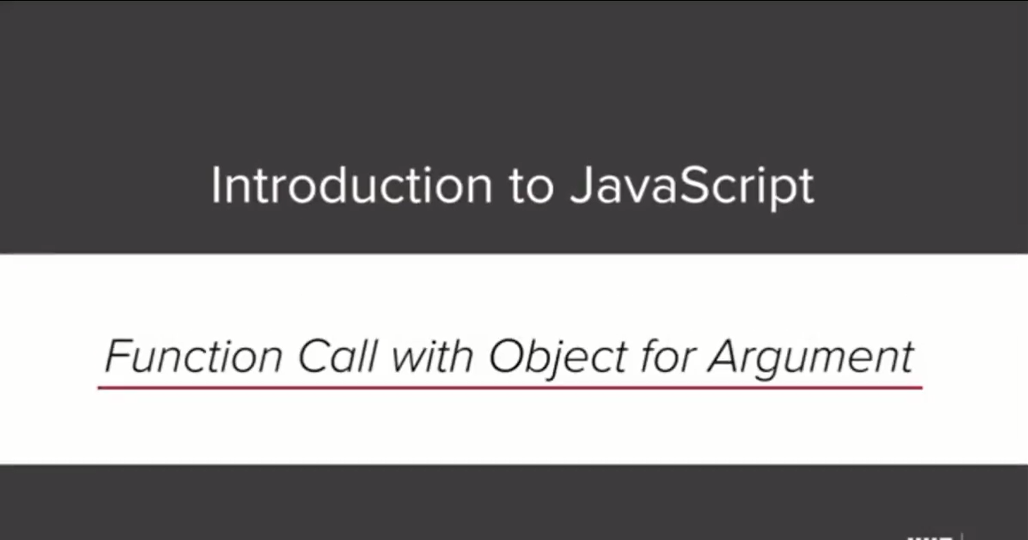

Slide 15
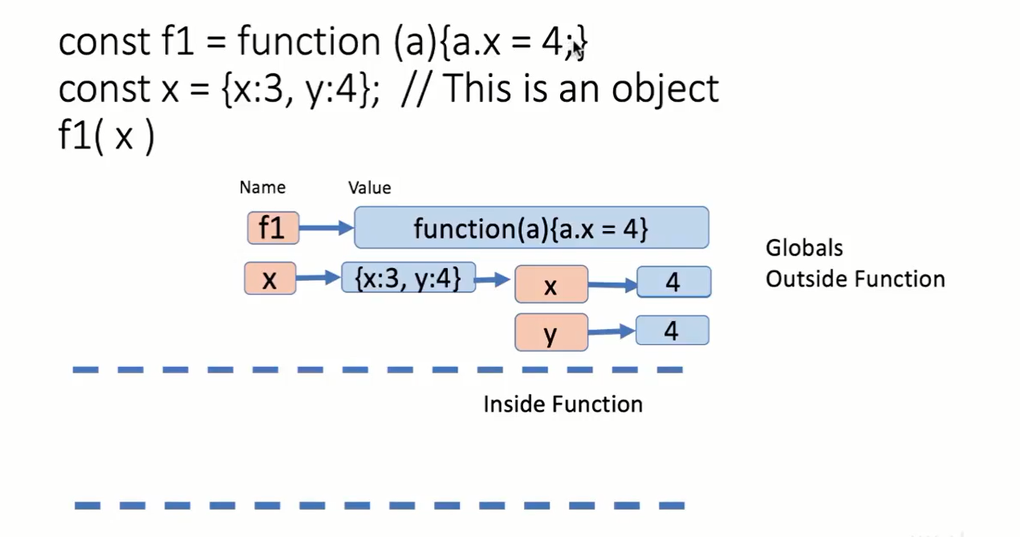

Slide 16
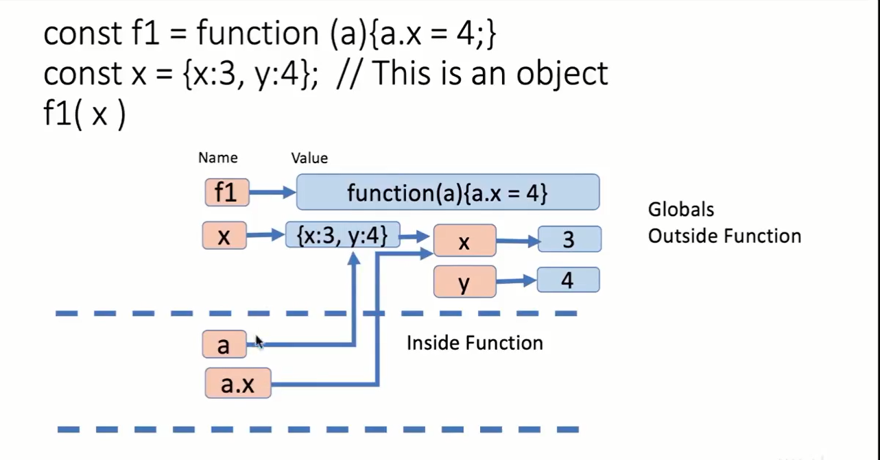

Slide 17
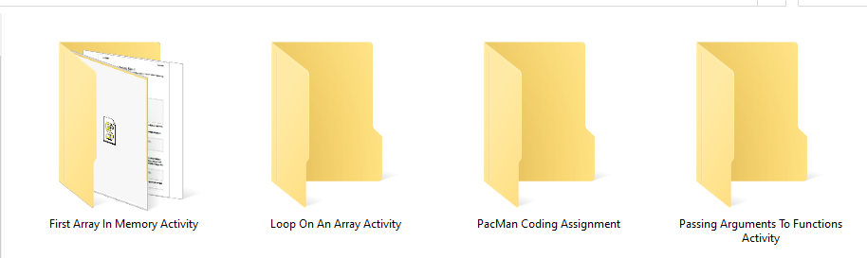
Learning Outcomes Addressed 1. Use parameters in functions 2. Use the switch operator to write code with multiple conditions

Slide 18
Pass By Value - Pass By Reference:
Passing an argument to a function by value makes a copy of that value, so the argument within the function becomes a separate copy of that value.
Passing by reference, via an object, means that the function is referencing the external object and acting upon it.
This is an important distinction you must understand as you create your own functions.

Slide 19
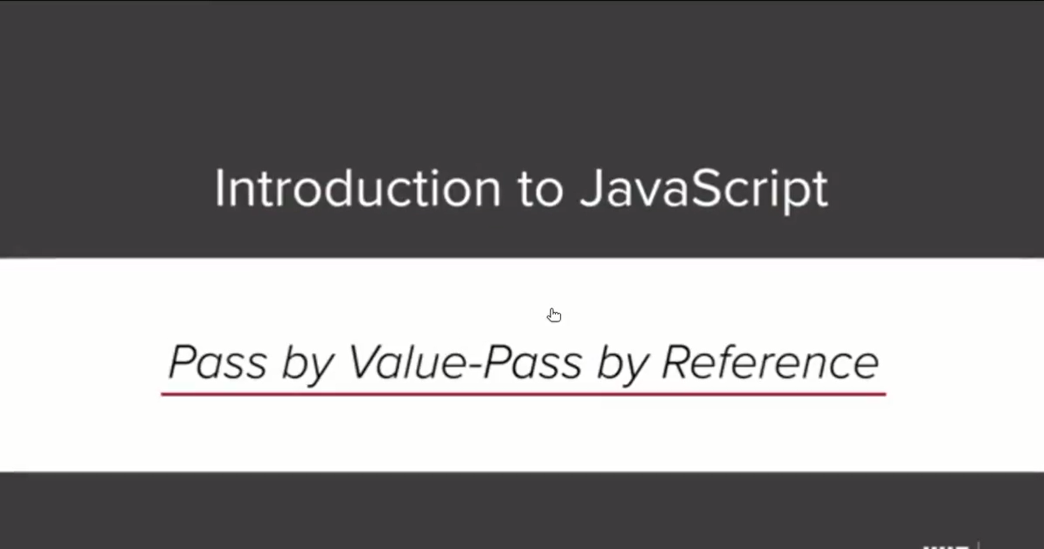

Slide 20
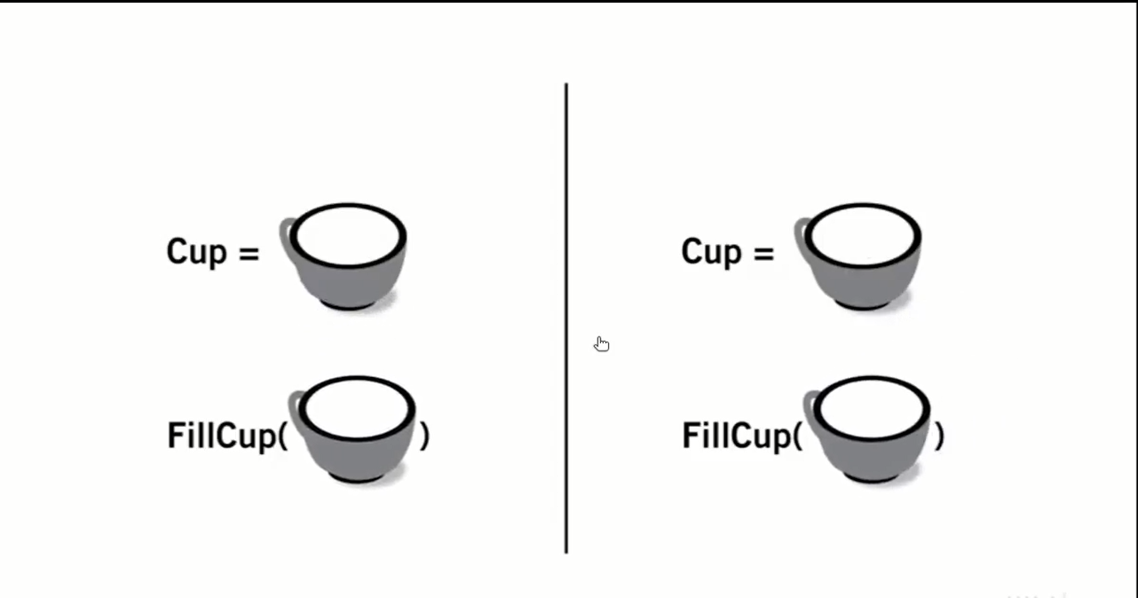

Slide 21
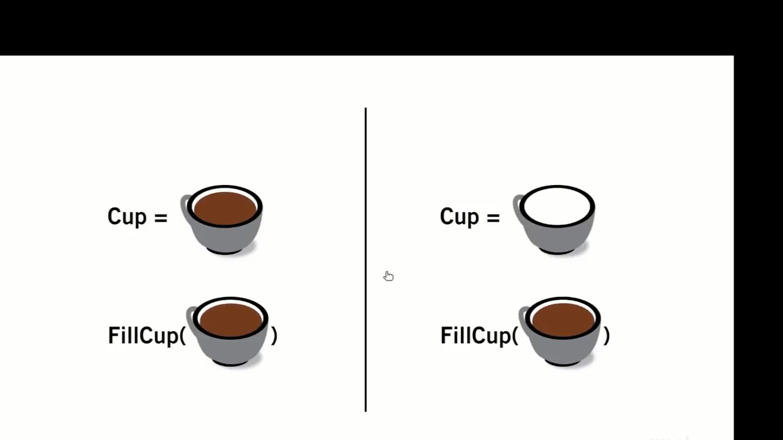

Slide 22
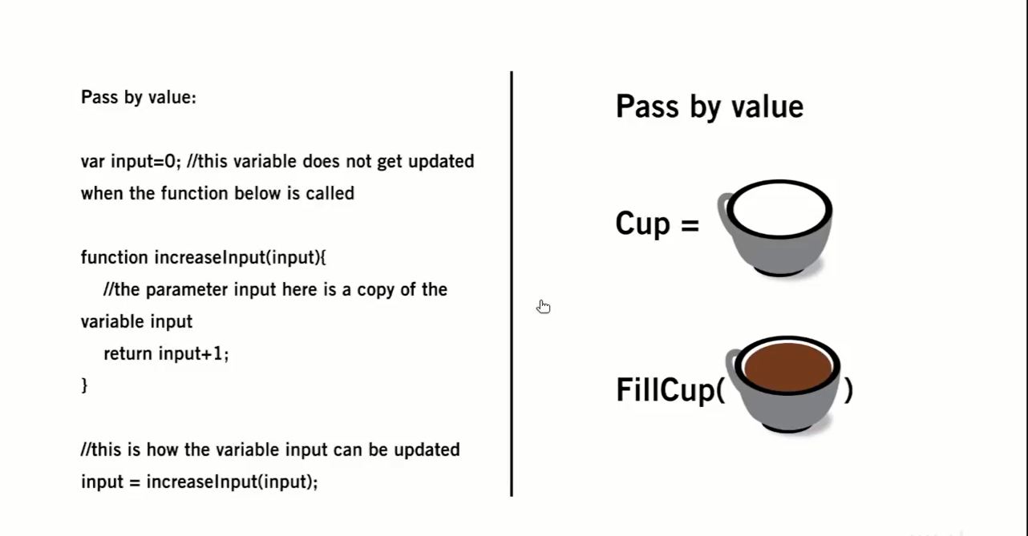

Slide 23
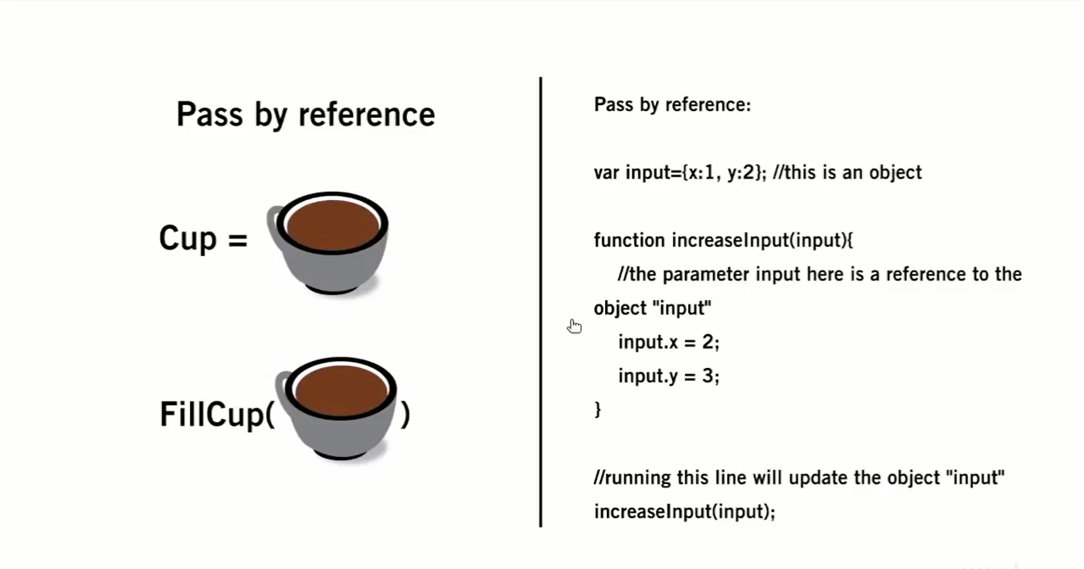

Slide 24
